Slide 1
Classification in Data Analytics

Slide 2
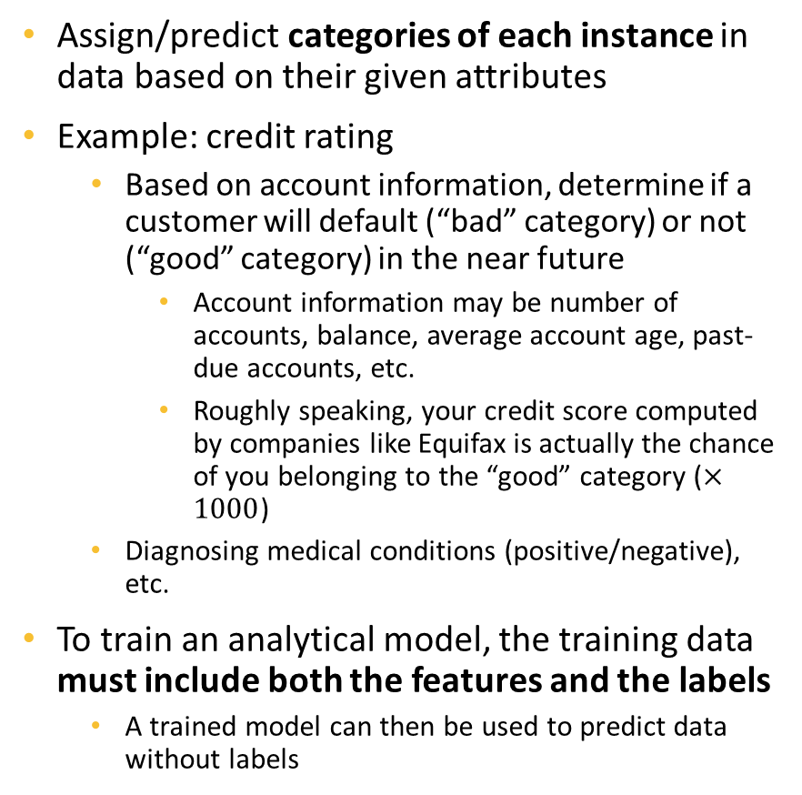
Review - Classification
Enc_SSN | NoOfAcc | Balance | 3MnPstDue | 6MnPstDue
Ad9asgvjabl | 3 | 100 | 0 | 0
CLvb0das9b | 1 | 2500 | 1000 | 500
MCdfasd924 | 4 | 50 | 0 | 0
Mx9ta9fgak4 | 2 | 1200 | 200 | 0
Ro04ik2lv90 | 4 | 200 | 50 | 0
Class
Good
Bad
Good
Good
Good
Assign/predict categories of each instance in data based on their given attributes
Example: credit rating
Based on account information, determine if a customer will default (“bad” category) or not (“good” category) in the near future
Account information may be number of accounts, balance, average account age, past-due accounts, etc.
Roughly speaking, your credit score computed by companies like Equifax is actually the chance of you belonging to the “good” category ($×1000$)
Diagnosing medical conditions (positive/negative), etc.
To train an analytical model, the training data must include both the features and the labels
A trained model can then be used to predict data without labels
Must provide both to train models
Enc_SSN | NoOfAcc | Balance | 3MnPstDue | 6MnPstDue
Ad9asgvjabl | 4 | 150 | 0 | 0
CLvb0das9b | 1 | 5000 | 3000 | 1000
Predict
Good
Bad
Only needs feature data to make predictions

Slide 3
Classification Models in this Module
“Models” refer to the algorithms that we will be using to solve an analytical tasks
Classification models are algorithms that are designed for the classification task. They are trained to map input feature data to output class targets
Models we will discuss in this module
Scikit-learn models:
Logistic Regression
Support Vector Machine
Decision Tree and Random Forest
AWS SageMaker models:
Extreme Gradient Boosting (XGBoost) Model
Note: in this module, we learn how the models work conceptually, and how to apply them. Deeper mathematical details of the models will not be discussed. Furthermore, the models we tried in this module are mostly in default parameters and therefore will not at their best in terms of performances. We will discuss what is finetuning and how to do that in the next module.
Ad9asgvjabl | 3 | 100 | 0 | 0
Model
Good
MCdfasd924 | 4 | 50 | 0 | 0
Model
Good
CLvb0das9b | 1 | 2500 | 1000 | 500
Model
Bad

Slide 4
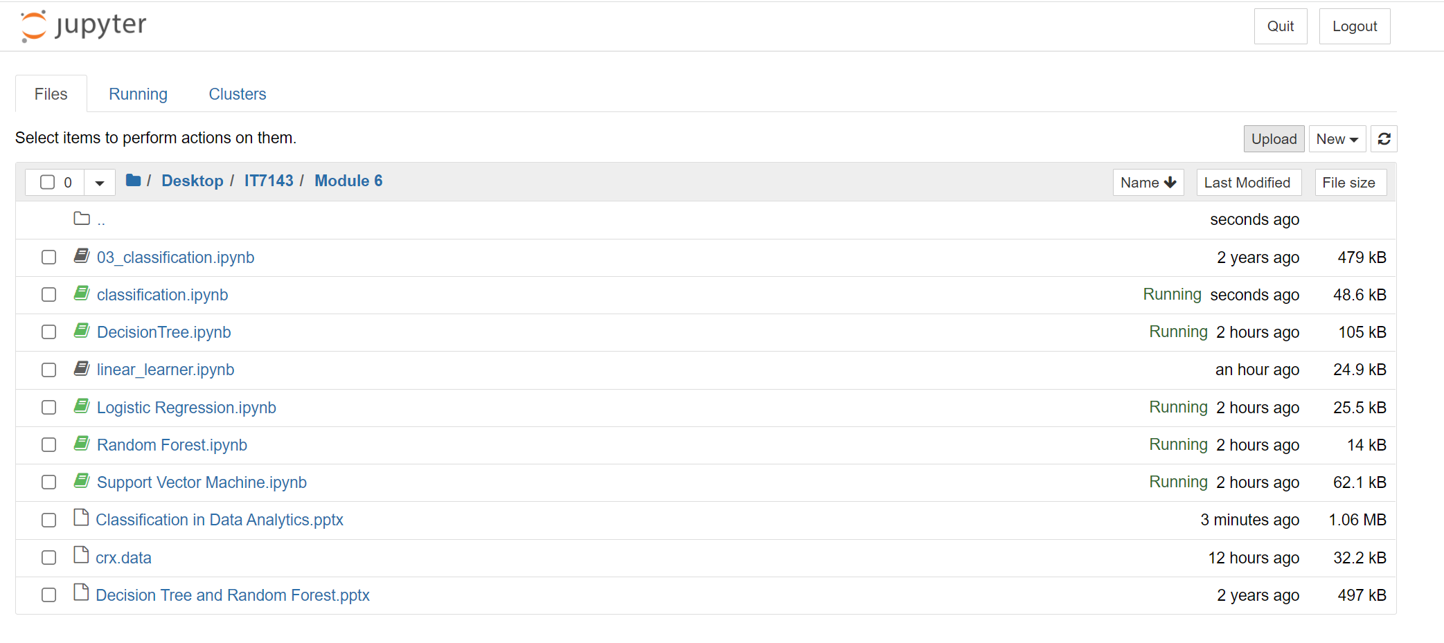
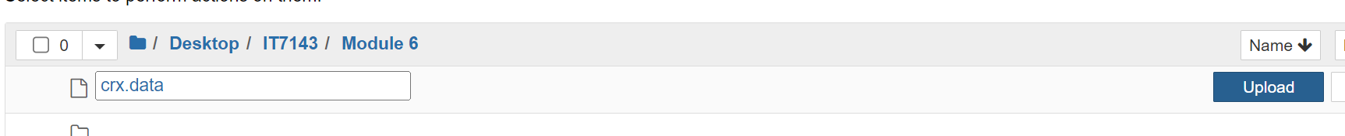
Uploading Data to SageMaker Notebook
We use the credit approval data for examples in this module. You need to upload the data and the sample notebook to the server as follows
Start the SageMaker Jupyter like the tutorial in Module 5
When the Jupyter Environment finishes starting up, open Jupyter GUI
Click on Upload. You will be prompted to select the files. Do not forget to click on the Upload button for each individual file

Slide 5
Classification Models’ Performances
To determine whether a model is good or bad, we need to evaluate its performance
For classification, there are multiple measurements to do this. Most if not all measurements are based on comparing the true labels of the data to predicted labels made by the model. In this module, we use the simplest measurement which is “accuracy rate”. The rest will be discussed in the next module
Accuracy rate is the ratio of instances get predicted with the correct labels over the whole dataset
True Label | Predicted Label
Good | Good
Good | Good
Bad | Good
Bad | Bad
Good | Bad
Bad | Bad
Four over six instances have their labels predicted correctly, the accuracy rate in this case is 0.6667, or 66.67%

Slide 6
Logistic Regression

Slide 7
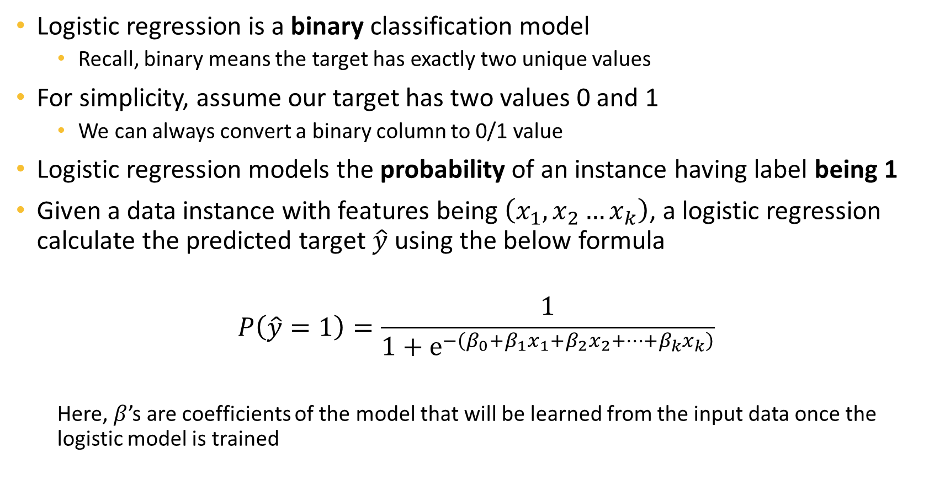
Logistic Regression
Logistic regression is a binary classification model
Recall, binary means the target has exactly two unique values
For simplicity, assume our target has two values 0 and 1
We can always convert a binary column to 0/1 value
Logistic regression models the probability of an instance having label being 1
Given a data instance with features being $\left(x_{1},x_{2}…x_{k}\right)$, a logistic regression calculate the predicted target $\hat{y}$ using the below formula
$$P\left(\hat{y}=1\right)=\frac{1}{1+e^{−\left(β_{0}+β_{1}x_{1}+β_{2}x_{2}+…+β_{k}x_{k}\right)}}$$
Here, $β$’s are coefficients of the model that will be learned from the input data once the logistic model is trained

Slide 8
Logistic Regression Example
Return to the credit rating example, we can train a logistic regression in this data
The equation may look like
Then, we can “plug” the actual numbers from each client to obtain their probability of “being good”
Enc_SSN | NoOfAcc | Balance | 3MnPstDue | 6MnPstDue
Ad9asgvjabl | 3 | 100 | 0 | 0
CLvb0das9b | 1 | 2500 | 1000 | 500
MCdfasd924 | 4 | 50 | 0 | 0
Mx9ta9fgak4 | 2 | 1200 | 200 | 0
Ro04ik2lv90 | 4 | 200 | 50 | 0
Prob
0.7
0.3
0.6
0.65
0.71
Class
Good
Bad
Good
Good
Good
$$P\left(\hat{y}=Good\right)=\frac{1}{1+e^{−\left(0.5+0.3NoAcc−0.1Balance−0.2PastDue3−0.4PastDue6\right)}}$$

Slide 9
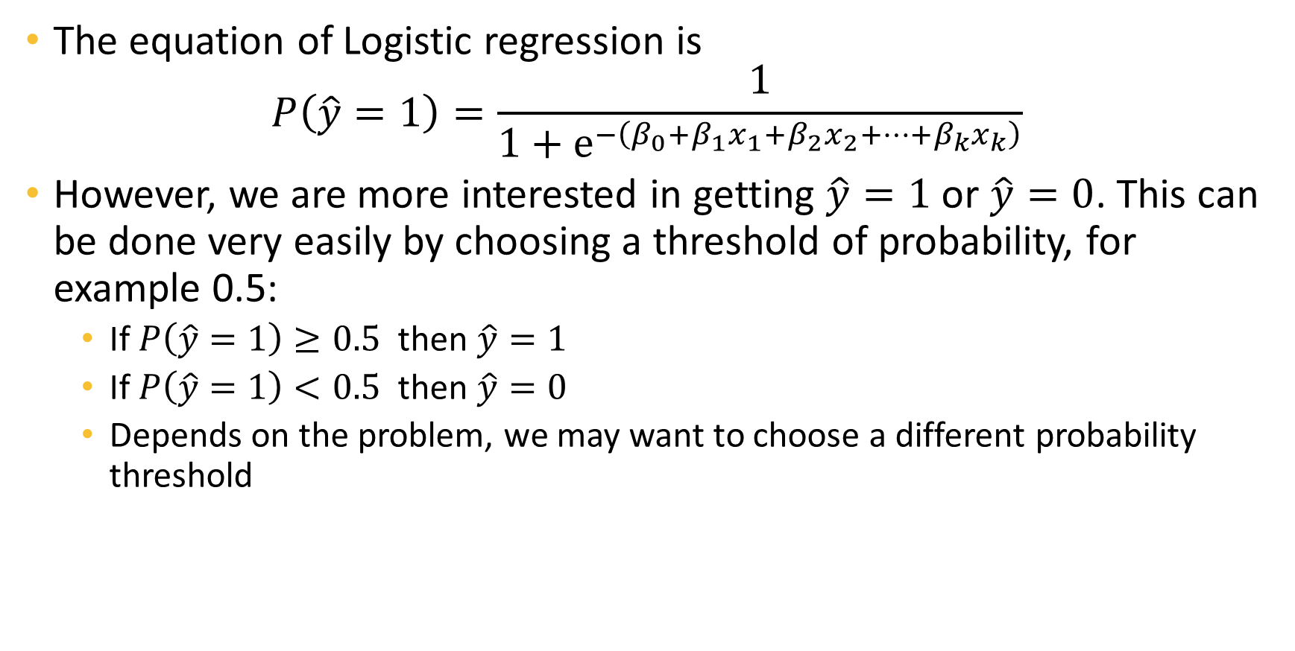
From Probability to Label
The equation of Logistic regression is
$$P\left(\hat{y}=1\right)=\frac{1}{1+e^{−\left(β_{0}+β_{1}x_{1}+β_{2}x_{2}+…+β_{k}x_{k}\right)}}$$
However, we are more interested in getting $\hat{y}=1$ or $\hat{y}=0$. This can be done very easily by choosing a threshold of probability, for example 0.5:
If $P\left(\hat{y}=1\right)≥0.5$ then $\hat{y}=1$
If $P\left(\hat{y}=1\right)<0.5$ then $\hat{y}=0$
Depends on the problem, we may want to choose a different probability threshold

Slide 10
Multilabel Classification with Logistic Regression
A single Logistic regression model cannot be applied to multilabel classification problems (i.e. there are more than two unique values in the target)
We use the 1 vs. all strategy – building multiple models that predict if the instance belong to each class or not.
For example, if the target has four unique values (1,2,3,4), we can have four models
1 vs. not 1 (i.e. y = 2,3, or 4)
2 vs. not 2 (i.e. y = 1,3, or 4)
3 vs. not 3 (i.e. y = 1,2, or 4)
4 vs. not 4 (i.e. y = 1,2, or 3)
Then pick the one that give the highest probability
Fortunately, this is transparent in SKLearn – we don’t need to worry about fitting multiple models, SKLearn automatically do that for us

Slide 11
Support Vector Machine

Slide 12
Support Vector Machine
A very famous model in Machine Learning, can be applied to both classification and regression
We begin with the simplest case of linear SVM binary classification

Slide 13





Linear SVM for Binary Classification
$$x_{2}$$
Let’s start with a very simple dataset
Two input features $x_{1}$ and $x_{2}$
Target is binary
And assume the instances of the two classes are separable (as in the figures)
The diamonds and circles are instances of the two classes
Instances in the two classes are not mixed when we plot them using $x_{1}$ and $x_{2}$
A simple strategy is to find a line that separate the two classes to make decision
But the are an infinite number of lines!
Linear SVM will tries to find an optimal line that separate the two classes
$$x_{1}$$
$$x_{2}$$
$$x_{1}$$

Slide 14
The Optimal Line that Separates the Classes
The optimal line that linear SVM found must
Separate the two classes
Maximize the margin between the two classes
Margin means the distances between the boundaries of the two classes
As it turns out, there is only one line that satisfies this condition
So, the solution from SVM is unique
The instances that lie on the boundaries are called Support Vectors, hence the name Support Vector Machine
Boundaries of the class
Maximized!

Slide 15
How to Make Decisions
After having the line, making decision is simple:
Anything under the line belong to one class
Anything above the line belong to the other class
Instances in this region belong to class circle
Instances in this region belong to class diamond

Slide 16
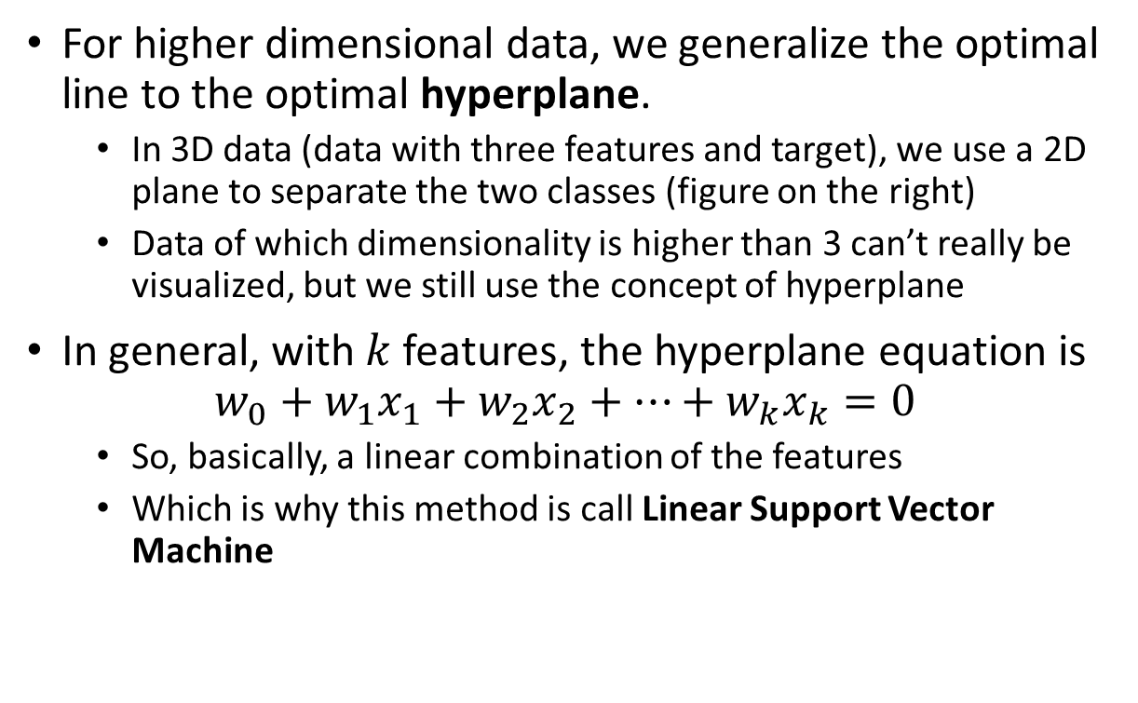
Into Higher Dimensional Data
For higher dimensional data, we generalize the optimal line to the optimal hyperplane.
In 3D data (data with three features and target), we use a 2D plane to separate the two classes (figure on the right)
Data of which dimensionality is higher than 3 can’t really be visualized, but we still use the concept of hyperplane
In general, with $k$ features, the hyperplane equation is
$$w_{0}+w_{1}x_{1}+w_{2}x_{2}+…+w_{k}x_{k}=0$$
So, basically, a linear combination of the features
Which is why this method is call Linear Support Vector Machine

Slide 17
Non-Separable Data
The data where instances are nicely distributed we used in the example is called linearly separable
And you can guess, we rarely, if ever, see them in practice
Data from real world are more non-linearly separable – instances of classes are mixed in the same areas
No linear boundary can be found
Linear SVM becomes insufficient
In such cases, we the kernel trick to obtain non-linear SVM
The new model is then called Kernel SVM
Is there any line that can separate the two classes in this case?

Slide 18
The Kernel Trick
Very roughly speaking, the kernel trick means to use something called a kernel function to transform/map data to an implicit higher dimensional space where instances of different classes suppose to be more linearly separable
This means, there are no guarantees that the kernel trick will work
And thus, we need to finetune the kernel functions
Implicit means we don’t actually know that new space to which the kernel function mapped data
Only know the instances’ similarity, represented by the values of the kernel function
We will discuss more on kernel SVM in the next module
Original Space
Kernel Trick
Higher Dimensional Space

Slide 19






Credit Rating Example
Enc_SSN | NoOfAcc | Balance | 3MnPstDue | 6MnPstDue
Ad9asgvjabl | 3 | 100 | 0 | 0
CLvb0das9b | 1 | 2500 | 1000 | 500
MCdfasd924 | 4 | 50 | 0 | 0
Mx9ta9fgak4 | 2 | 1200 | 200 | 0
Ro04ik2lv90 | 4 | 200 | 50 | 0
Class
Good
Bad
Good
Good
Good
$$NoOfAcc$$
$$Good Clients$$
$$6MnPstDue$$
$$Bad Clients$$
$$3MnPstDue$$
$$Balance$$

Slide 20
Tree and Ensemble Models

Slide 21
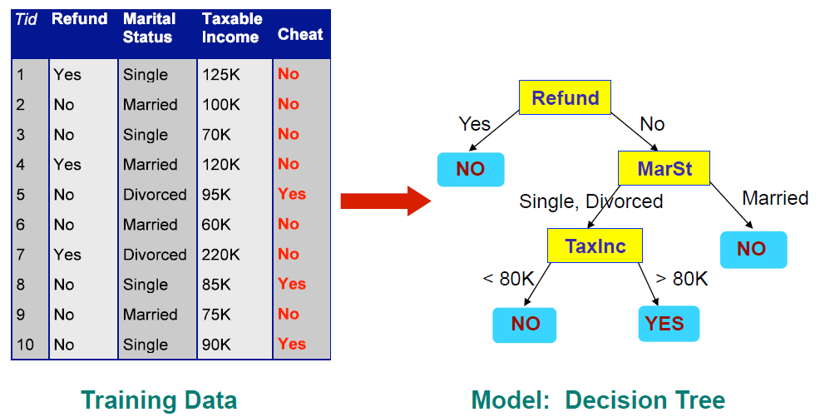
Decision Tree
Has a flowchart/tree-like representation
Each node represents a test on columns of data
Each branch represents an outcome of the node’s test
Terminal/leaf nodes decide the predicted labels of the instances

Slide 22
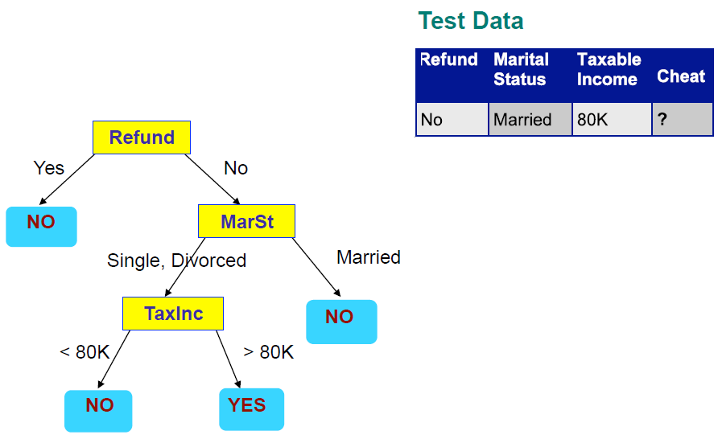
Applying a Tree to Test Data
Start from the Root Node

Slide 23
Random Forest
You may have guessed from the name, a Random Forest is an ensemble model that consists of multiple decision trees
Each tree is fit/trained using a random subset of the data (in terms of both instances and features)
When make predictions, each tree generates its own predicted values. The final decision is “voted” among the trees – the value with more tree predicted wins
The use of multiple trees
Stabilizes the model
Mitigates overfitting
Improve performances in general

Slide 24
Extreme Gradient Boosting (XGBoost) Model
An ensemble of tree models similar to Random Forest
Unlike random forest, the trees are not added to the ensemble randomly but rather with an objective of minimizing the training errors
Provided in AWS SageMaker
Class
Good
Bad
Good
Good
Good
Enc_SSN | NoOfAcc | Balance | 3MnPstDue | 6MnPstDue
Ad9asgvjabl | 3 | 100 | 0 | 0
CLvb0das9b | 1 | 2500 | 1000 | 500
MCdfasd924 | 4 | 50 | 0 | 0
Mx9ta9fgak4 | 2 | 1200 | 200 | 0
Ro04ik2lv90 | 4 | 200 | 50 | 0

Slide 25
Additional Reading
Logistic regression
https://scikit-learn.org/stable/modules/generated/sklearn.linear_model.LogisticRegression.html
Support Vector Machine
https://scikit-learn.org/stable/modules/generated/sklearn.svm.SVC.html
Decision Tree
https://scikit-learn.org/stable/modules/tree.html
Random Forest
https://scikit-learn.org/stable/modules/generated/sklearn.ensemble.RandomForestClassifier.html
XGBoost
https://docs.aws.amazon.com/sagemaker/latest/dg/xgboost_hyperparameters.html

